Slide 1

Flights

Slide 2

The steps to analyize our data
Understanding the Data
Data Cleaning and Preprocessing
Asking Useful Questions
Data Visualization
Data Analysis and Interpretation

Slide 3
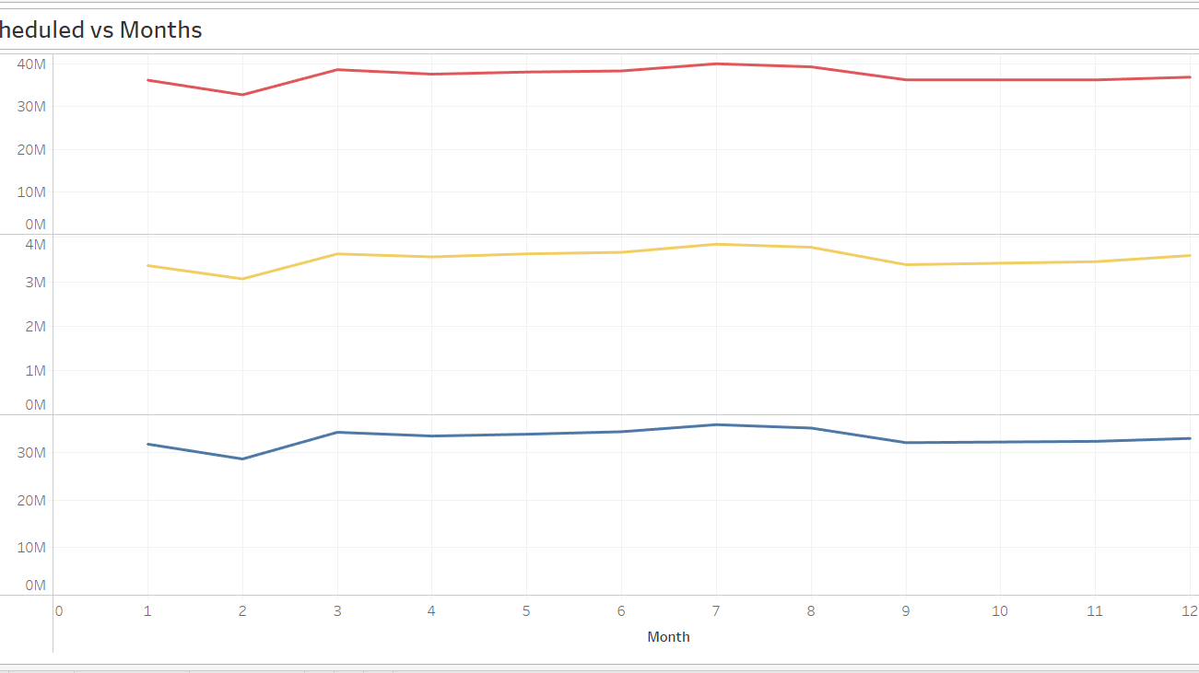
Are there specific months when travel bookings (flights, trains, buses) peak or dip?

Slide 4
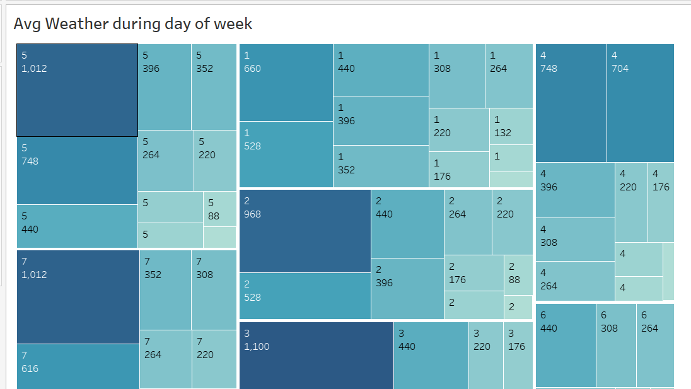
What is the average temperature, precipitation, or humidity for each month?

Slide 5
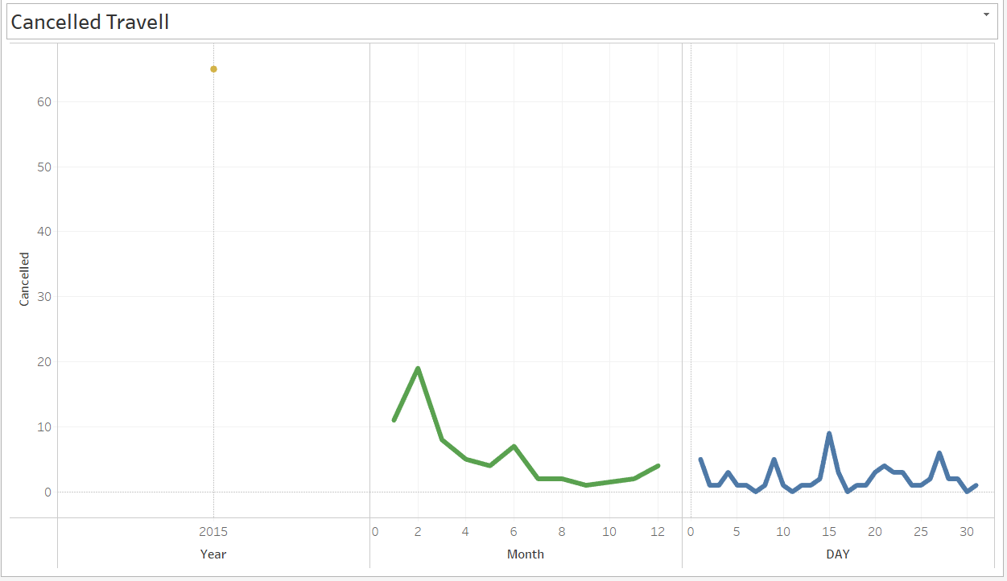
What are the common reasons for flight or hotel booking cancellations?

Slide 6
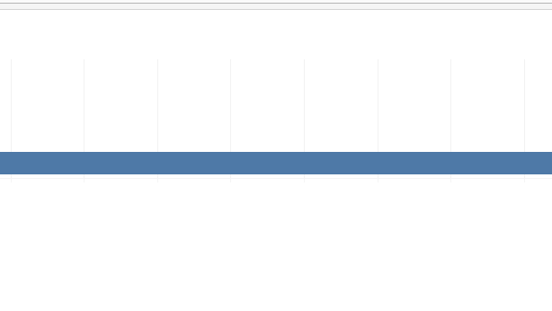
Analyze arrival times for various scenarios:

Slide 7
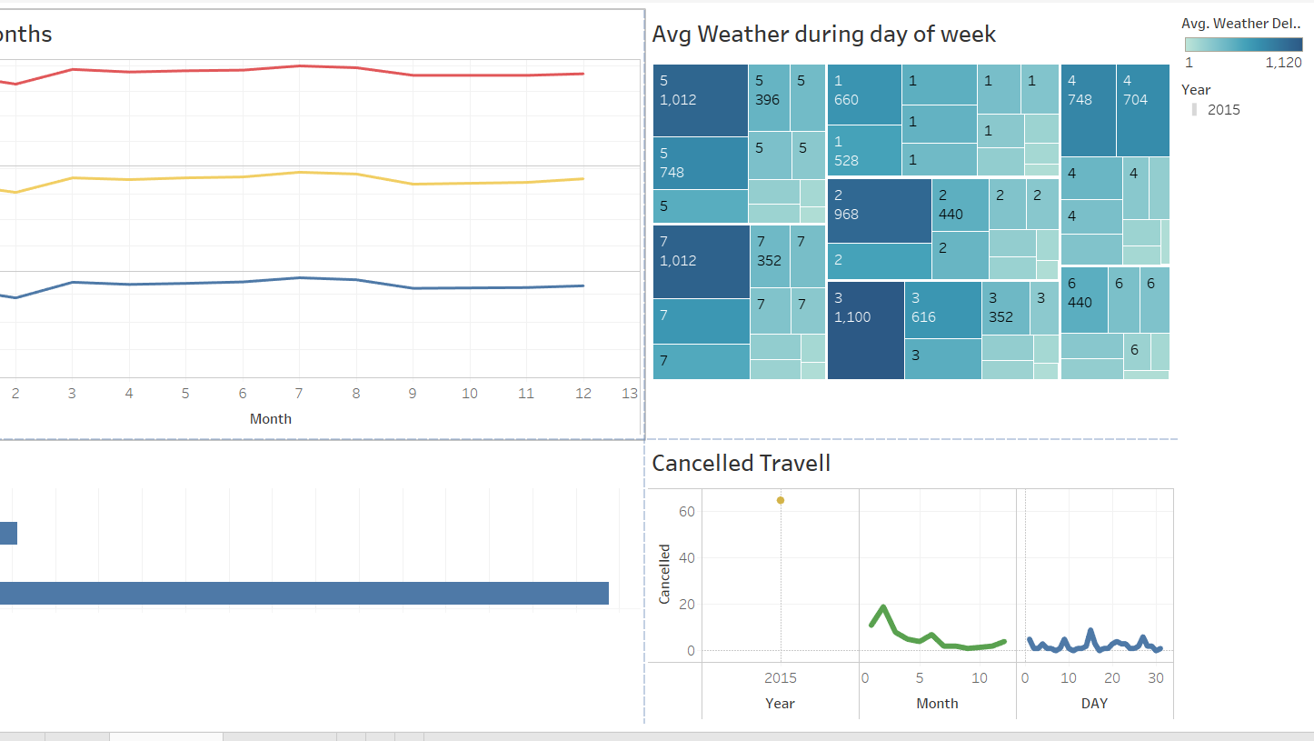

Slide 8
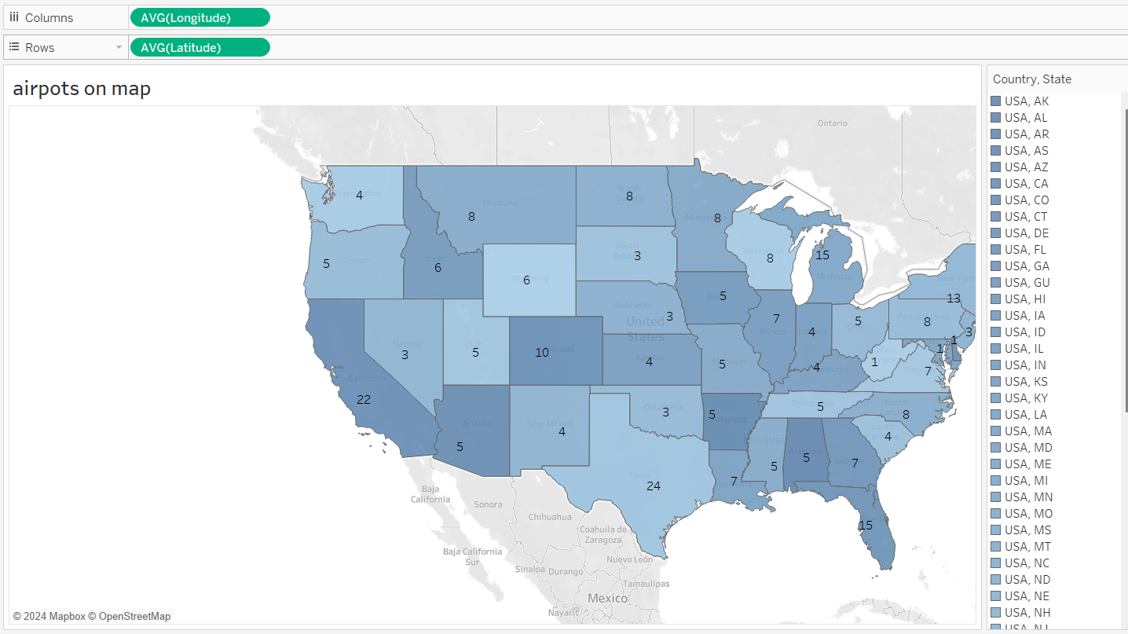
How do the number and types of airports (major, regional, private) vary across different states

Slide 9
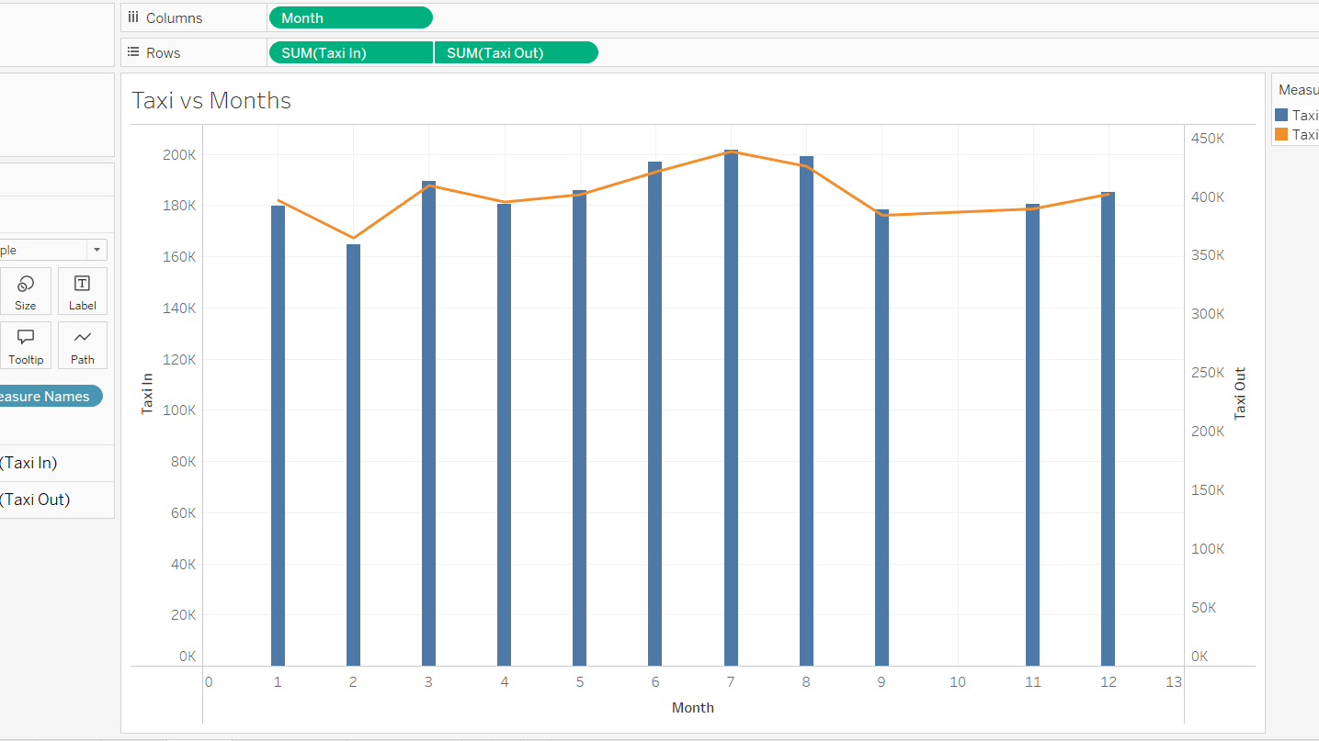
How do taxi-in and taxi-out times vary over months or seasons?

Slide 10
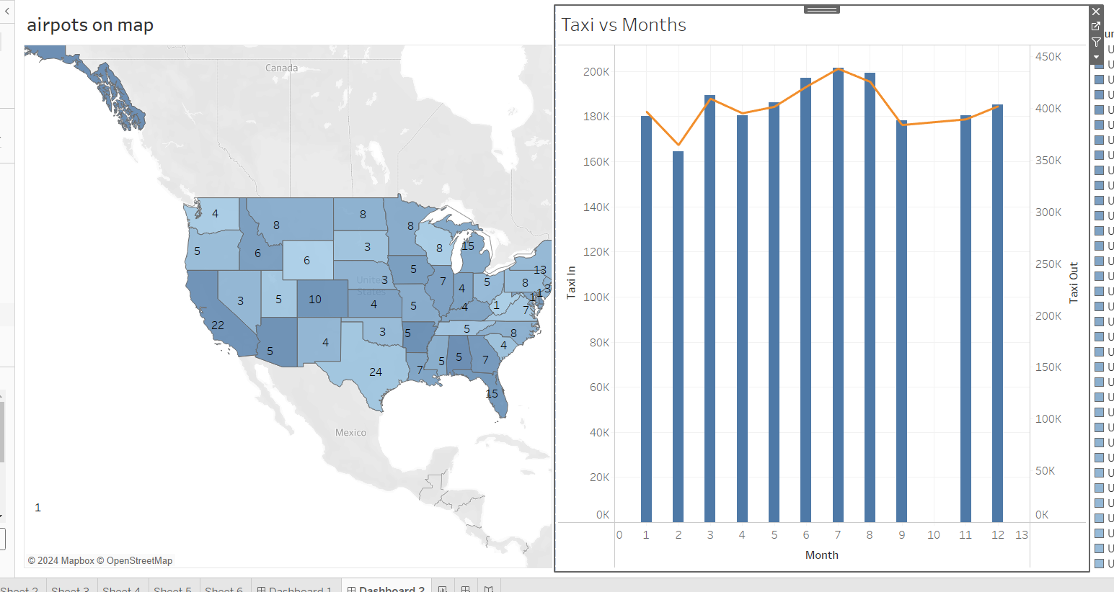

Slide 11

Thanks

